Slide 1

CMR COLLEGE OF ENGINEERING & TECHNOLOGY
Kandlakoya, Medchal, Hyderabad - 501401
Department of Computer Science and Engineering
Online Job Search& Recruitment System In Android Environment Using Intelligent Agent
Batch No:15
Name of the student:
K .Yugender (20H51A05H4)
Under esteemed guidance of
Guide Name
Ms.B.Anuradha(Assistant Professor)
Batch: 2020-2024 Major Project Phase 2

Slide 2
Outline
Abstract
Introduction
Research Objective
Problem Definition
Scope of the Project
Literature Review
Proposed Methods
Architecture
Conclusion
References
Notes:
2

Slide 3
Abstract
Notes:
3

Slide 4
Abstract
In today's diverse job market, both job seekers and employers encounter significant
challenges. Job seekers often struggle to find opportunities aligned with their skills
and experiences, while employers face difficulties in identifying candidates who can
contribute effectively to organizational growth. These hurdles extend beyond tech
giants, affecting individuals offering niche services like barbering, babysitting, makeup
artistry, and event coordination. To address these issues, a comprehensive solution is
proposed, leveraging technology and innovative platforms. By connecting skilled
individuals with relevant opportunities and assisting employers in finding the right
talent, this solution aims to democratize access to employment opportunities and foster
inclusive growth across industries.
Ultimately, the goal is to create a robust framework for job matching that promotes
economic participation and empowers individuals to leverage their skills for meaningful
employment and socioeconomic advancement.

Slide 5
INTRODUCTION
Notes:
5

Slide 6
Introduction
Rapid changes in the labor market due to digital technologies
Introduction of the state-of-the-art Online Job Search System
Facilitates seamless connections between job seekers and employers
Replaces outdated methods like postal applications and classified ads
Businesses struggle to find qualified candidates; job seekers face challenges in finding
suitable positions
Project addresses shared challenges across industries
Highlights untapped potential of skilled individuals in various fields
Notes:
6

Slide 7
Research Objective
Notes:
7

Slide 8
Research objective
The research objectives for this project are as follows:
Evaluate the efficacy of the Online Job Search System in enhancing job search efficiency
for both job seekers and employers.
2. Identify and analyze the specific challenges faced by businesses in talent acquisition and
by job seekers in securing suitable employment opportunities within the modern job
market landscape.
3. Investigate the transformative impact of digital technologies on traditional job search
methodologies and their relevance in today's labor market dynamics.
4. Assess the scalability and adaptability of the Online Job Search System to cater to the
diverse needs of industries, encompassing both large corporations and small-scale enterprises.
5. Examine the extent to which the Online Job Search System addresses common obstacles
encountered by job seekers and employers across various professions, while also exploring
its role in empowering individuals in niche fields to access job opportunities and showcase
their skills.

Slide 9
Problem Definition
Notes:
9

Slide 10
Problem Definition
The main problem statement for this project finding a job is tough in these days. People
spend a lot of time searching for jobs online, but most websites don't help match job seekers
with the right employers, and there's no feedback from employees about their experiences.
To solve this, we want to create a smart computer program that helps job seekers find the
best job matches by talking to employers and using special rules. It will also show how
good an employer is based on feedback from their employees. This program will work
on Android phones and use specific tools to make it easy to use.

Slide 11
Scope of the Project
Notes:
11

Slide 12
Scope of the Project
The scope of the project encompasses the development and implementation of the Online
Job Search System, integrating advanced algorithms to personalize job recommendations,
collaborating with businesses to understand talent acquisition needs, researching market
trends for relevance, conducting user testing for iterative improvements, exploring partnerships
for skills enhancement, ensuring data security, providing comprehensive support services,
evaluating socio-economic impact, and developing a sustainable roadmap for expansion and
continuous innovation.

Slide 13
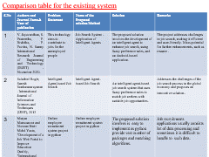
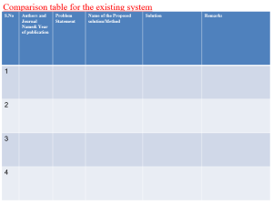
Literature Review
Notes:
13

Slide 14
Comparison table for the existing system
S.No | Authors and Journal Name& Year of publication | Problem Statement | Name of the Proposed solution/Method | Solution | Remarks
1 | V. Jayavardhan, S. Praneetha, P. Rishitha, P. Pavitra, N. Sunny International Research Journal of Engineering and Technology (IRJET) - November 2020. | This technology aims to contribute to jobs for the unemployed people | Job Search System - Application of Intelligent Agents | The proposed solution involves the development of an intelligent agent to enhance job search, using fuzzy preference rules, and an Android-based application. | The project addresses challenges in job search, making it efficient and user-friendly. It has potential for further enhancements, such as resume .
2 | Salathiel Bogle, Suresh Sankaranarayanan. International Journal of Information Sciences and Techniques (IJIST), 2012 | Intelligent Agent-based Job Search | Intelligent Agent-based Job Search | An intelligent agent-based job search system that uses fuzzy preference rules to match job seekers with suitable job opportunities. | Addresses the challenges of the job search process in the global economy and proposes an innovative solution.
3 | Gousia Hazra Anjum Khan, Gangeshwari, Dronesh, Sacitha Singh,” Online Job Search and Recruitment System – A Career Site,” International Research Journal of Engineering and Technology (IRJET) Volume 8, Issue 05, May 2021. | Online employee recruitment system project in python | Online Job Search & recruitment system -A Career Site. | The proposed solution involves is easy to implement as python provide vast number of packages and matching algorithms. | Job recruitments applications usually consists lot of data processing and sometimes it is difficult to handle to such data.

Slide 15


Slide 16
Proposed Method
Considering the anomalies in the existing system computerization of the whole
activity is being suggested after initial analysis.
The android application is developed using Android Studio with JAVA as a
programming language.
Proposed system is accessed by two entities namely, User and Recruiter.
Admin need to login with their valid login credentials first in order to access
the android application.
After successful login, user and recruiter can access their respective modules
and perform/manage each task accurately and seamlessly.

Slide 17
ARCHITECTURE

Slide 18
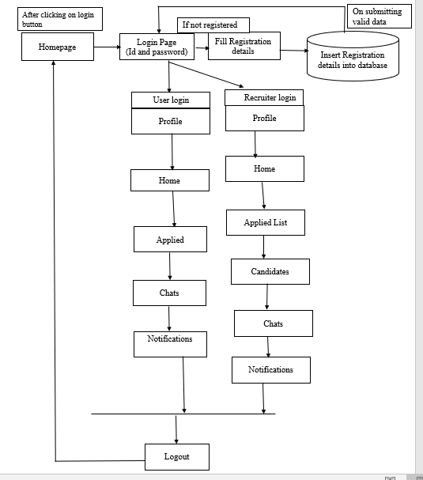

Slide 19
Performance Analysis
Test Condition | Input specification | Output specification | Pass/Fail
The user is currently on login screen | User enters credentials and click on login button | Enters to job screen | Pass
User is currently on job post /job seek screen | User clicks on job seek button | Directs to jobs list | Pass
User is currently on job post /job seek screen | User clicks on job post button | Directs to post a jobs | Pass
The user is currently on job page | User enters job credentials | User applied for the job | Pass
The user is currently on job post page | User enters job description | User successfully post the job | Pass

Slide 20
Result
This project aims to simplify and enhance the job search process for individuals. It
introduces intelligent agents to assist job seekers by evaluating their preferences and
matching them with suitable job opportunities. Additionally, it includes a novel feature
where past and current employees can rate and provide feedback on employers. This
project offers a user-friendly solution utilizing modern technology, potentially
revolutionizing the way people find employment opportunities and assess employers,
making the job search process more efficient and informed.

Slide 21
Conclusion
In conclusion, the dynamic nature of the labor market demands creative approaches
to tackle the issues encountered by employers and job searchers. In this sense, a
major advancement has been made with our state-of-the-art Online Job Search System,
which uses digital technology to optimize the hiring process and promote smooth
interactions between talent and companies. With only a few clicks, our platform gives
users access to a wide network of customized job prospects, removing obstacles like
postal applications and classified advertisements and improving accessibility and efficiency
in the job search process.
Additionally, our initiative emphasizes how critical it is to identify and capitalize on
the unrealized potential of talented people in a variety of occupations, including driving,
event planning, barbering, and more. Our method supports economic growth and
individual and company empowerment by giving these gifted people a platform to
demonstrate their skills and make connections with chances for financial gain.
Essentially, our Online Job Search System is a catalyst for positive change in the labor
market, promoting more efficiency, inclusion, and opportunity for all parties concerned.
It is a technology improvement as well.

Slide 22
Future Work
Incorporating advanced AI and machine learning for improved job matching
precision.
Integrating blockchain for secure credential verification and decentralized
job marketplaces.
Implementing predictive analytics to anticipate job market trends and
recommend skill development.

Slide 23
References
Marjan Mansourvar and Norizan Binti Mohd Yasin, "Development of a Job Web Portal
to Improve Education Quality, "International Journal of Computer Theory and Engineering,
Vol. 6, No. 1, February 2014
V.Jayavardhan, S.Praneetha, P.Rishitha, P.Pavithra, N.Sunny,” Job Search System –
Application of Intelligent Agents,” International Research Journal of Engineering and
Technology (IRJET) Volume 7, Issue 11, Nov 2020.
https://graphviz.org/doc/info/lang.html
Salathiel Bogle, Suresh Sankaranarayana “Intelligent Agent Based Job Search System
in Android Environment” IEEE International Conference 2011.
Gousia Hazra Anjum Khan, Gangeshwari, Dronesh, Sacitha Singh,” Online Job Search and
Recruitment System – A Career Site,” International Research Journal of Engineering and
Technology (IRJET) Volume 8, Issue 05, May 2021

Slide 24
Thank You!

